Slide 1
Flower Recognition System Based On Image Processing
Course Name : Computer Vission And PATTERN RECOGNITION
Sec : B
Group No : B
Group Members :
1)Asadur Rahman ( 18-37447-1)
2)Shazzad Hossain Shovon ( 17-34884-2)
3)Mahmud Hasan ( 17-33881-1)
4)Md.rashedul islam ( 19-40559-1)
5) Sk.Mohiuddin ahmed ( 19-40126-1)

Slide 2
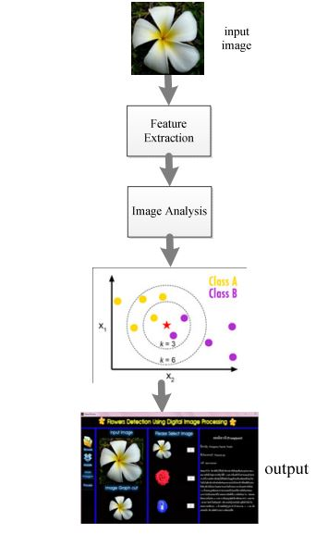
Flower Recognition System Based On Image Processing

Slide 3
Flower Recognition System Based On Image Processing
References :
(PDF) Flower recognition system based on image processing (researchgate.net)

